Slide 1
Introduction to Hadoop

Slide 2
Hadoop
The open source MapReduce implementation
Developed initially by Yahoo! in 2008.
The implementation is based on the following paper by researchers from Google, published in 2004
Jeffrey Dean and Sanjay Ghermawat, MapReduce: Simplified Data Processing on Large Clusters, OSDI 2004
Hadoop has turned into THE platform for big data
According to Parikh, “Hadoop is used in every Facebook product and in a variety of ways.”

Slide 3













Who uses Hadoop?

Slide 4

What Hardware is Hadoop Designed for?
Nodes of commodity PCs connected via network
This is often called cluster of workstations
Each node has its own:
Disk
CPUs
Memory
Very scalable architecture

Slide 5
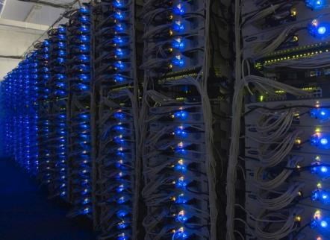
Very Large Hadoop Deployment in Data Centers
Hadoop spread over thousands of shared nothing nodes/blades.
Nodes/blades are grouped into racks
Each node/blade within a rack has own
memory, disk, CPUs
Communication within nodes/blades faster than across racks
Higher bandwidth
Lower latency

Slide 6
Minimize Data Movement
The shared nothing architecture of Hadoop mean data movement across nodes is expensive.
Goal of Hadoop is to minimize data movement
Move computation to data
The map phase computation does not generate any network traffic since it just operates on the data within its local partition
Minimize cost of data shuffle
Write code that minimizes the amount of data shuffled.
Better shuffle algorithms

